Slide 1
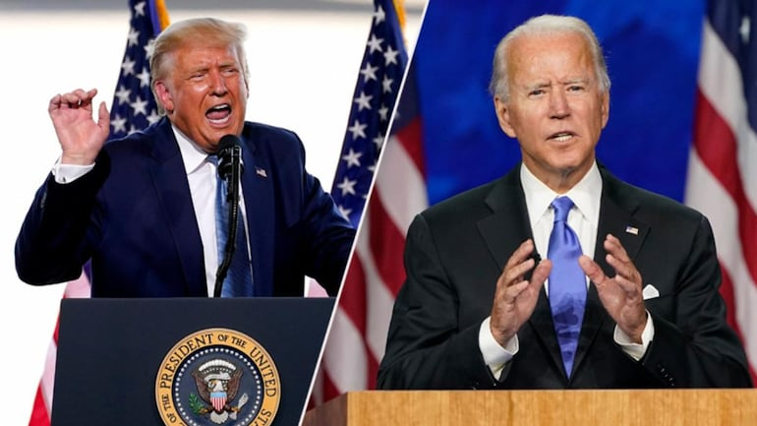
The November 2020 Elections
Relationship Between Labor Movements, Paid Leave, and Voter Turnout

Slide 2
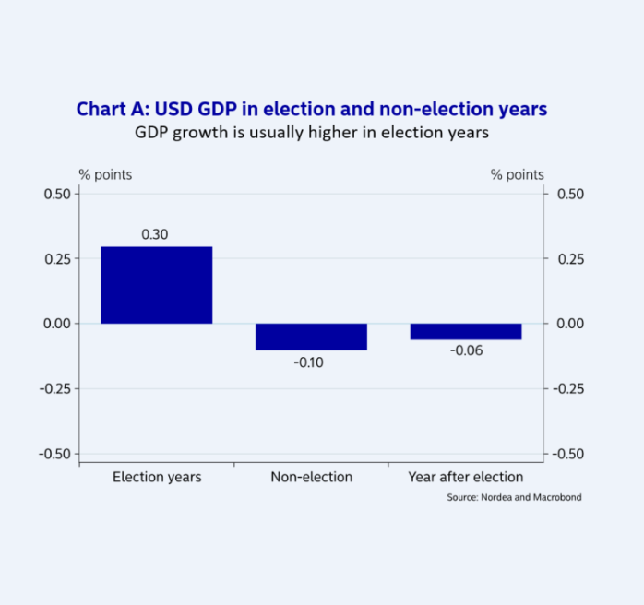
Background
The U. S. economy faces uncertainty every election year due to the general confusion created by passionate supporters.
As presented by individual candidates, the policies provide an overview of how the next administration is going to influence the business environment.
The most significant concerns for investors include regulatory policies, interest rates, government spending, and public debt.
Candidates’ incentives translate to slight growth in the economy in the runup to elections.
Notes:
Every election year, the U. S. economy usually faces significant confusion, as partisan supporters voice out their passionate concerns and beliefs, creating uncertainty in investors. For most investors, the most significant concern is usually the policies and possible legislation as presented by the candidates and the potential influence of the next administration on productivity (Kingsly, 2016). These often include regulatory policies, interest rates, government spending, and the public debt (Kingsly, 2016). Generally, the United States' business environment behaves calmly in the runup to an election, with data showing a tendency for the market to encourage economic gain due to the little incentives spearheaded by individual candidates (Kingsly, 2016).

Slide 3
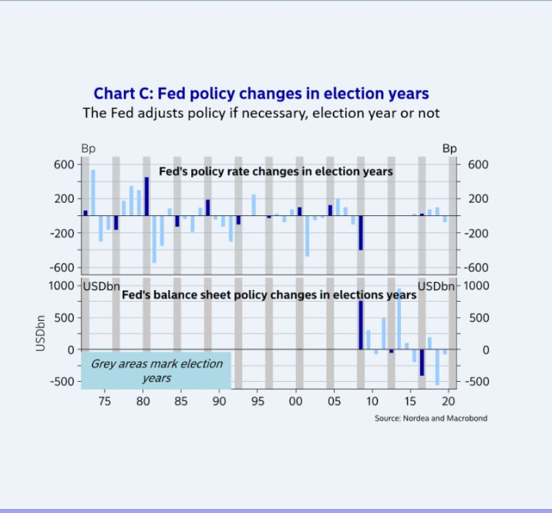
Current Situation
The November 2020 elections seem to have created different economic results, unlike the other election years.
Changes in fiscal policy, like the Fed policy, which stimulate economic growth, were initiated two to three years before the election year.
Recent changes in voter-leave policies do not provide clear directions to employers in complying with the requirements.
The limitations of the voter-leave policies are bound to influence voter turnout.
Notes:
The circumstances seem to be different with the November 2020 elections due to specific reasons. Fiscal policy is often the driving force behind the slight economic growth in election years, contributing to a 0.4% growth in the economy and an average 0.3% growth in GDP (Lund & Svendsen, 2020). However, for the current administration, these fiscal policies were 'offloaded' two to three years before the election years (Lund & Svendsen, 2020). Though the move contributes to up to 0.5-1%-point growth in GDP, the economy was already experiencing growth, which resulted in contradictions in counter-cyclical fiscal balance (Lund & Svendsen, 2020). Additionally, recent reviews on voting-leave policies have failed to provide clear guidelines to influence employer compliance in most statesc. Therefore, this is set to affect voter turnout adversely.

Slide 4
Critical Factors
The November 2020 election outcomes are anchored on three fundamental factors.
The economy is at the center, with the so-called Misery Index used to “predict” election outcomes.
The relationship between the Misery Index and voter turnout is anchored on labor movements’ advocacy on changes in voting-leave.
The economics of swing states and their markets are bound to experience significant shifts as presidential campaigns focus on these.
Notes:
Therefore, three critical factors are set to define how the November 2020 elections in the United States will play out. The first is the economy, where the so-called Misery Index, which is the sum of unemployment rates and inflation in the country, is used to evaluate the economy and “forecast” possible election outcomes (Lund & Svendsen, 2020). The Misery Index is set to determine voter turnout in various ways, including prompting voters to choose between going to work and going to vote. The other factor is the swing states, for instance, Michigan, Pennsylvania, and Wisconsin, which significantly influenced the 2016 elections (Lund & Svendsen, 2020). Therefore, since a disproportionately huge part of the campaigns will take place in these states, their markets and economics are bound to experience significant shifts (Lund & Svendsen, 2020).

Slide 5
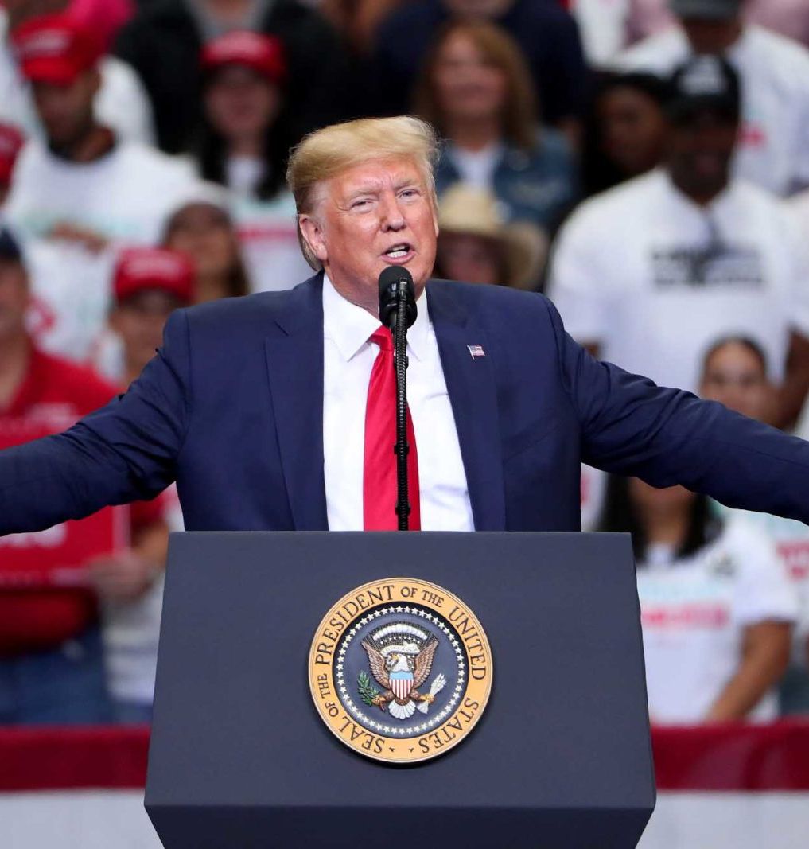
Implications of a Trump Win
The current administration has become famously known for its violation of employee rights and labor movements' oppression.
The oppressions have established precedence that is most likely to be followed after reelection.
President Trump's reelection has been associated with positive economic performances and considerable economic growth.
The reelection may also cause a further slowdown in global manufacturing sectors, particularly car manufacturing in Europe.
Notes:
The Trump administration's first tenure has not been favorable for American workers, as it has seen a systematic rollback of workers' rights and freedom of labor movements (Pulfrey, 2020). Therefore, based on the legislation developed by this administration, such oppressions are bound to continue once reelected. Despite this, Wall Street analysts have described President Trump's reelection as the most favorable for the U. S. and global economies. These arguments are based on data collected following previous presidential reelections, which triggered positive economic performances, suggesting that President Trump's reelection would have similar effects (Bernstein, 2020). However, the opposite also seems to be true. For instance, the current administration's trade wars are largely blamed for the slowdown in global manufacturing sectors, particularly in Europe's car manufacturing industry (Lund & Svendsen, 2020). This means reduced ability by employers to offer paid leave and an increased rate of exploitation.

Slide 6
Implications of a Trump Win (Cont.)
The value of the dollar is bound to increase significantly following Trump’s reelection.
Economic sectors bound to benefit most following Trump’s reelection include carbon energy sectors, big tech sectors, and renewable energy sectors.
The traction experienced in ESG investing is also bound to continue following the reelection.
By ensuring law and order, Trump’s reelection is bound to create conducive environments for businesses to thrive.
Notes:
Additionally, President Trump’s reelection is bound to contribute to a significant appreciation of the dollar due to the heightened trade tensions and the broader geopolitical uncertainty. Furthermore, various sectors, including carbon energy sectors, big tech sectors, and renewable energy sectors, are bound to perform better under a Trump reelection (Borowski et al., 2020). It is believed the ESG investing will also gain significant traction under Trump’s reelection, as increased disclosure and the accelerating ESG equity flows are bound to continue. Finally, the law and order theme that is characterizing the Trump reelection campaign is bound to create a conducive environment for U. S. businesses to thrive and pull investments into the country (Borowski et al., 2020).

Slide 7
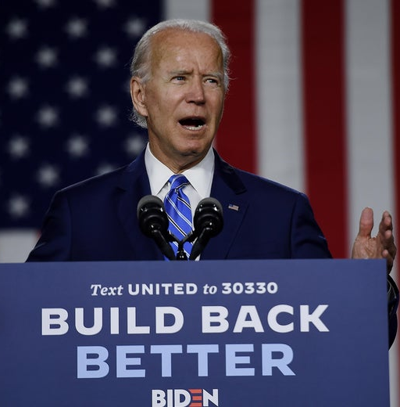
Implications of a Biden Win
The Biden candidature has been identified as the labor-friendly potential administration due to the commitment to reverse labor inequalities.
A Biden win implies significant infrastructural developments, which will stimulate the economy and ensure employee rights.
The promise to support the Green New Deal will facilitate a reduction in economic inequality and establish high-paying jobs.
Notes:
A Biden win has been associated with the revival of labor unions in America after suffering major blows from the current administration (Pulfrey, 2020). The potential administration is said to have plans to reverse the country's long history of declining labor union memberships. The labor-friendly administration has promised to establish major infrastructure to significantly stimulate the economy and ensure employees' rights are met (Borowski et al., 2020). Furthermore, Biden has promised to support the Green New Deal's modifications, a proposed legislation package that seeks to address the issues of climate change and economic inequality through social and economic reforms (Borowski et al., 2020). Among the most significant economic implications of this legislation is the creation of high-paying jobs.

Slide 8
Implications of a Biden Win (Cont.)
A Biden win presents ‘stability’ that can be translated into a stable environment for business growth and economic stability.
A Biden win would mean amendments of international relations between America and the East, facilitating international trade.
If Biden wins, there is a high chance for the restoration of the US-EU relations, whose deterioration has affected the manufacturing industry.
Notes:
Additionally, the 'stability' associated with Biden may translate to economic stability and create a stable environment for business growth if he wins the November elections. The potential Biden presidency is also bound to ease the ongoing capital war on foreign holdings, tech war, and the current economic tensions between the current administration and the East (Chu, 2020). Easing up these trade barriers would encourage international trade, thus, facilitate the development of the trade deal through improvements in international relations. Finally, a Biden win would see the restoration of positive US-EU relations, meaning that the current hurdles in manufacturing, particularly car manufacturing, would cease (Borowski et al., 2020).

Slide 9
Implications of a Balance of Power
The current balance of powers has resulted in the undermining of employee rights and labor movements/unions.
Currently, anti-worker legislations are on the rise, posing the danger of undercutting the establishment and relevance of labor movements.
The legislations have short and long-term effects on individual employees.
Long term impacts include weakened employee voices, increased exploitation, and stagnation in real wages.
Notes:
There are currently ongoing wars in the United States Congress and the House of Representatives regarding the organization and powers of labor unions and movements in collective bargaining (Potrafke, 2018). Under the current balance of power between the Democrats and Republicans in the two houses, anti-worker legislations are bound to undercut the establishment of labor movements and collective bargaining. The current situation is bound to decimate public workers' rights, leaving them at the mercies of their employers, who may exploit them at will (Potrafke, 2018). In the long-term, predictions include weakened employee voices, increased exploitation, and stagnation in real wages.

Slide 10
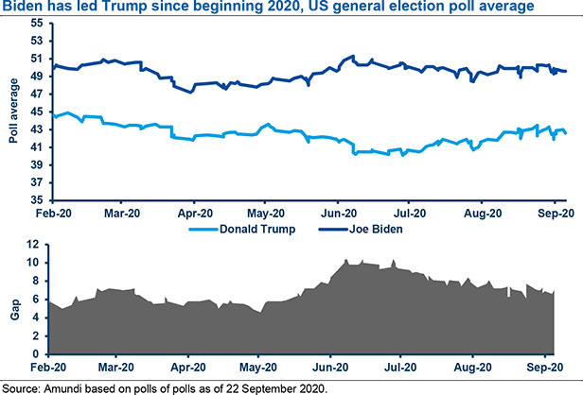
Quality Polls
Joe Biden has maintained a steady lead over Donald Trump throughout the year.
Most political betting sites have settled on Biden as the favorite candidate to win the election.
The volatility and fluidity of polls contribute to increased outcome uncertainties.
Factors like swing states, voting turnout, and the political debates have significant impacts on outcomes.
Notes:
Throughout the year, Biden has maintained a considerable lead over President Trump in the national polls by a 7.3% lead as of September 2020 (Borowski et al., 2020). However, Joe Biden's lead has significantly reduced from 10.4% lead in June 2020. Currently, political betting sites identify Biden as the favorite, with some sites giving him as high as a 60%-win rate (Borowski et al., 2020). Regardless of these, the outcomes remain uncertain as the polls’ trajectory is significantly fluid and volatile. Additionally, factors like the swing states, voting turnout, and political debates significantly impact the election outcomes (Borowski et al., 2020).

Slide 11
References
Borowski, D., Pirondini, M., Todd, C. & Upadhyaya, P. (2020). US Presidential Election: How It Will Impact Us Economy and Financial Markets. Amundi Asset Management. Retrieved from https://research-center.amundi.com/page/Article/Amundi-Views/2020/09/US-presidential-election-how-it-will-impact-US-economy-and-financial-markets
Lund, M. & Svendsen, A. (2020). Electionomics: The US election’s impact on the economy and financial markets. Open Insights by Nordea. Retrieved from https://insights.nordea.com/en/economics/us-election-economy/
Kingsly, K. (2016). The US Elections and Impact on Financial Markets with Zoom in Central Africa. Available at SSRN 2875967.
Potrafke, N. (2018). Government ideology and economic policy-making in the United States—a survey. Public Choice, 174(1-2), 145-207.
Pulfrey, C. (Ed.). Voting-Leave Law Changes Require Employer Compliance, Flexibility. Bloom Tax. Retrieved from https://news.bloombergtax.com/payroll/voting-leave-law-changes-require-employer-compliance-flexibility

